Slide 1
Can we predict movements in the NSE Nifty index via data science techniques?

Slide 2
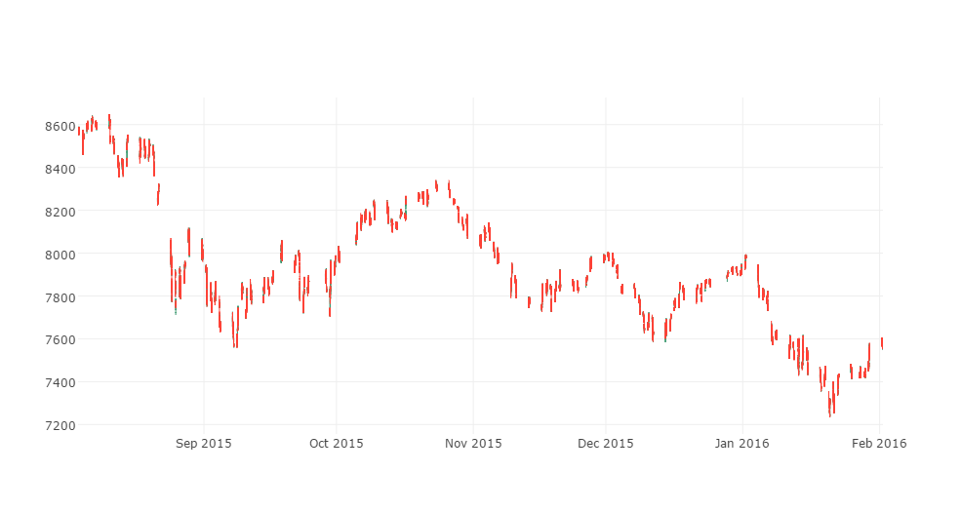
Notes:
Data from Bloomberg. 1-minute Open, High, Low, Close, Volume. Aug 3 2015 to Feb 1 2016. Market is open from 1145-1800 SGT. Why NSE Nifty? Very fluid; fairly independent of other markets (so (i) this problem is harder (ii) arguably, we’re not really missing a key explanatory variable i.e., the leading market… in some sense.)

Slide 3
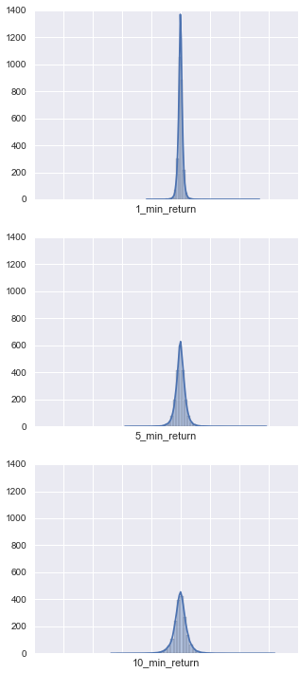
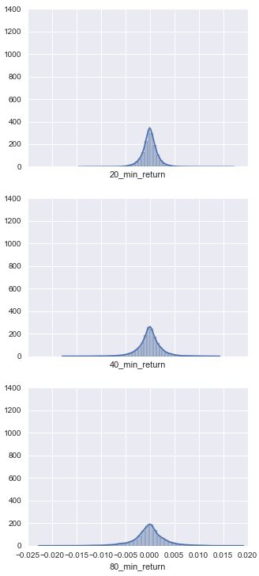
Notes:
We look at 1, 5, 10, 20, 40, 80 minute timeframes for most things. Response variables: x-minute % return; up/down, categorical (1/3, 1/3, 1/3), high categorical (5%, 90%, 5%).

Slide 4
FEATURES
x-minute…
prior % return
last price vs moving average
log volume vs historical
log buying up / selling down
buying up / selling down by time of day
high-low range
price vs range
‘near the open’ / ‘near the close’
Notes:
We made several other features / versions of these features, but these are the ones that made it into the PCA.

Slide 5
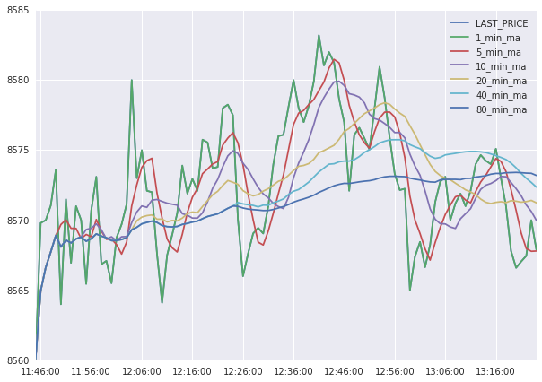
Notes:
Example of moving average. We’ll take (last price – x-min MA) as the feature.

Slide 6
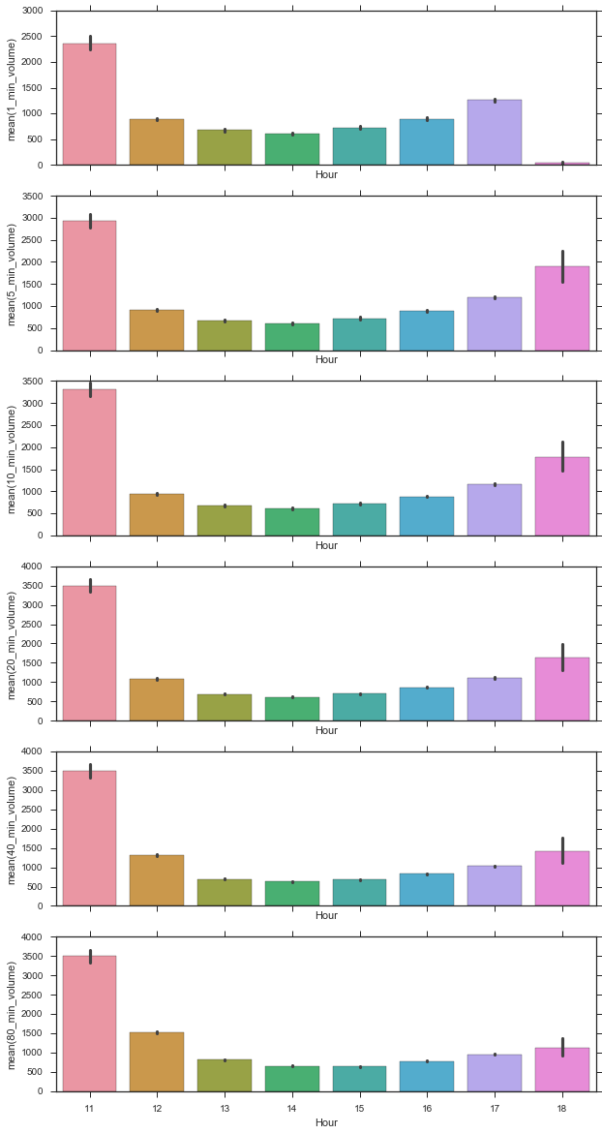
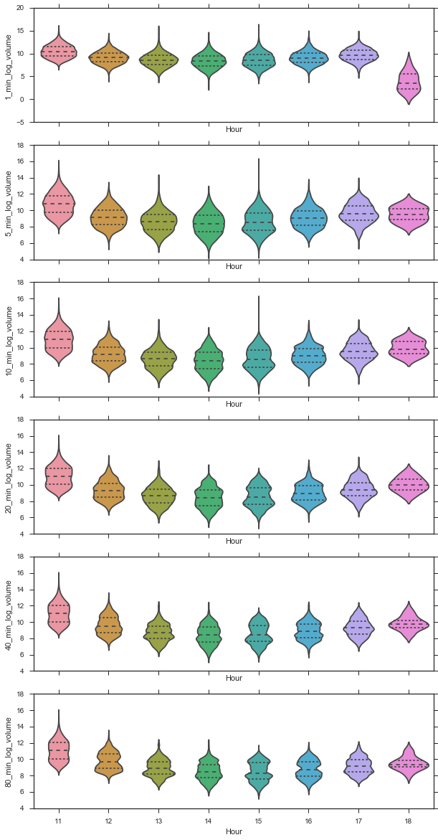
Notes:
Volume varies by hour of day. Even log volume varies a lot by hour of day. This also suggests that whether we’re ‘near the open’ or ‘near the close’ (time-wise) could be useful features.

Slide 7
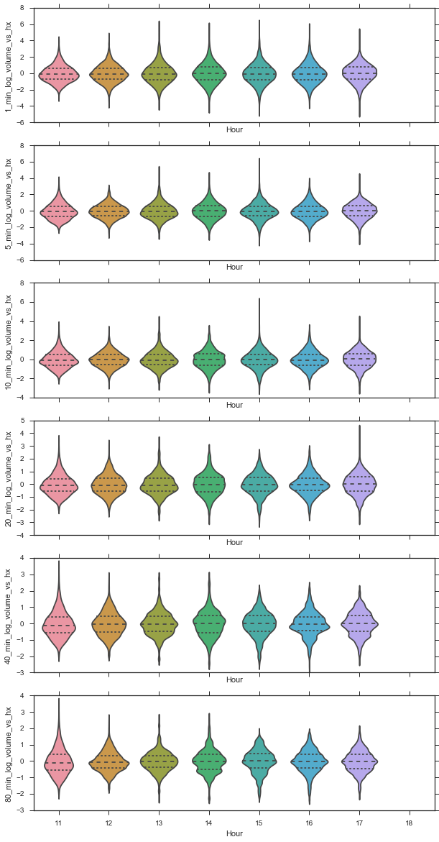
Notes:
So, we look at a feature that is log-volume relative to the usual log-volume for this time of day. Specifically, we look at log-volume for a given hour of day, averaged over the last 10 days. We then compare the current log-volume to that 10-day average, that’s our feature. From the plot you can see its much more well behaved.

Slide 8
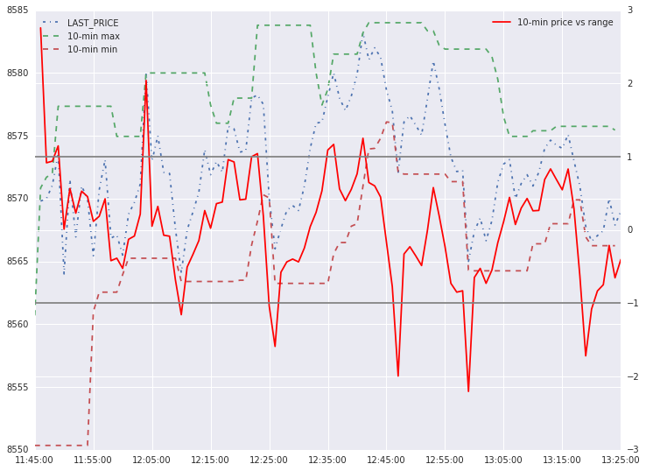
Notes:
Here we are picturing price vs x-minute range. It’s what the current price is relative to the 1-minute ago (x-minute min, x-minute max) range. And we recenter it so at high is 1, at low is -1, it can exceed [-1, 1] if it’s a breakout
Buying up / selling down: basically, volume * whether the price moved up or down.
High-low range: high over x-minutes – low over x-minutes

Slide 9
Exploratory Data Analysis

Slide 10
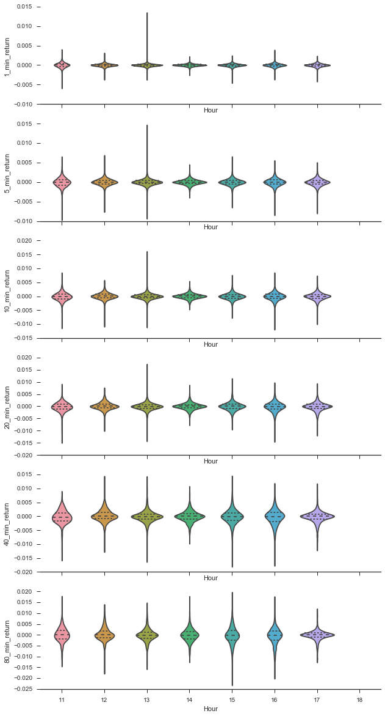
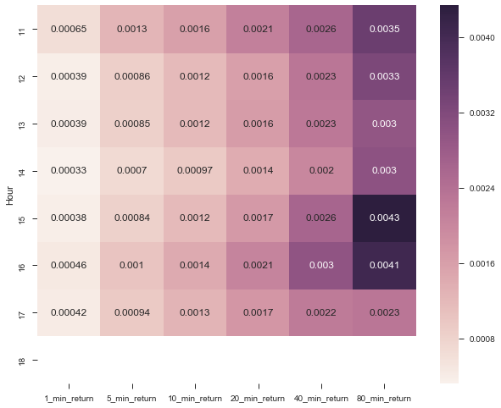
Notes:
Mean return doesn’t vary with hour of day. Variability of returns tends to be somewhat higher near open and close (look at the fatness of the violin plots not the wicks; look at the heatmap of stdev). This is in line with our expectation that ‘near the open’ and ‘near the close’ could be useful indicators.

Slide 11
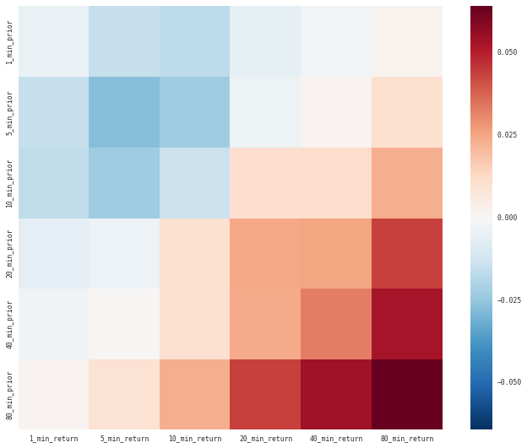
Notes:
There’s some pattern of relationship between prior returns and future returns. This is a correlation heatmap. Short-term prior returns are negatively correlated with short-term future returns; longer-term prior returns are positively correlated with longer-term future returns.

Slide 12
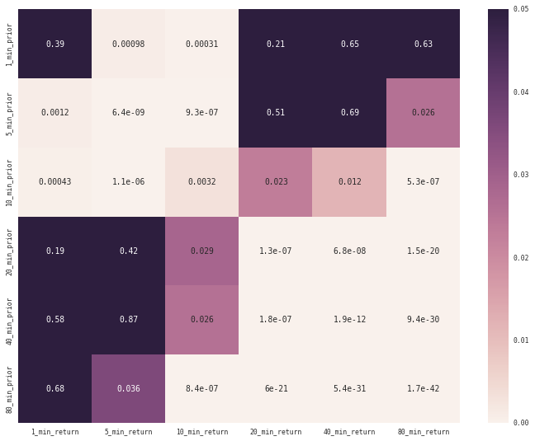
Notes:
Magnitude of relationship is small but it may be statistically significant. Here, black squares are NOT statistically significant; beige squares ARE statistically significant.

Slide 13
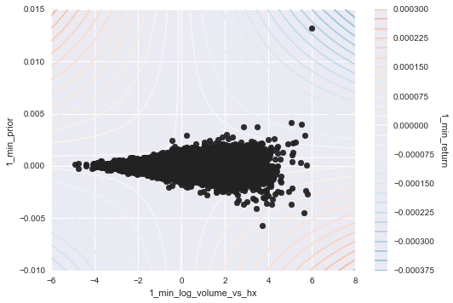
Notes:
Interaction effects: volume + prior return => returns
Short-term: high 1-min volume + high 1-min prior return =>low 1-min return

Slide 14
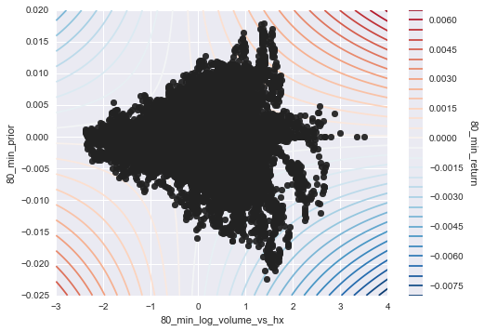
Notes:
Long-term: high 80-min volume + high 80-minprior return => high 80-min return

Slide 15
DIMENSIONALITY REDUCTION

Slide 16
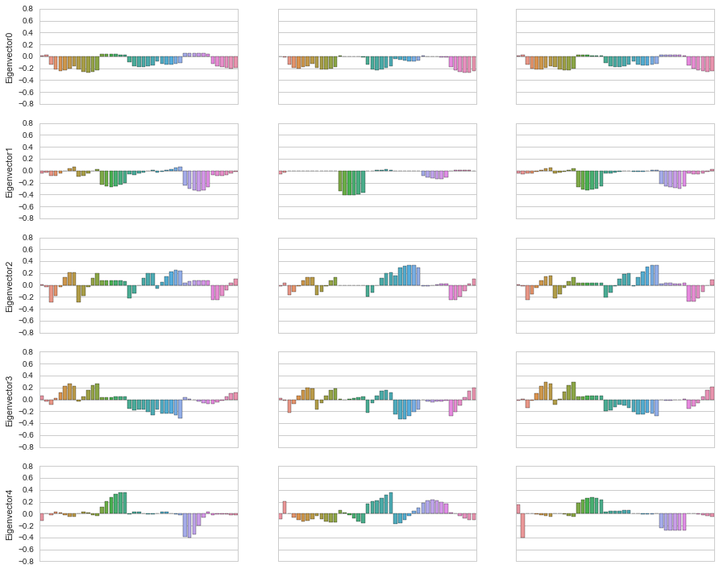
Notes:
Tried to see if PCA solution was stable across 3 folds of the data. Here are top 5 eigenvectors, they do appear to be similar.
feature_columns = ['near_open','near_close',
'1_min_prior','5_min_prior','10_min_prior','20_min_prior','40_min_prior','80_min_prior',
'5_last_vs_ma','10_last_vs_ma','20_last_vs_ma','40_last_vs_ma','80_last_vs_ma',
'1_min_log_volume_vs_hx','5_min_log_volume_vs_hx','10_min_log_volume_vs_hx','20_min_log_volume_vs_hx','40_min_log_volume_vs_hx','80_min_log_volume_vs_hx',
'1_min_busd_log','5_min_busd_log','10_min_busd_log','20_min_busd_log','40_min_busd_log','80_min_busd_log',
'1_min_busd_time','5_min_busd_time','10_min_busd_time','20_min_busd_time','40_min_busd_time','80_min_busd_time',
'1_min_hilo','5_min_hilo','10_min_hilo','20_min_hilo','40_min_hilo','80_min_hilo',
'1_min_price_vs_range','5_min_price_vs_range','10_min_price_vs_range','20_min_price_vs_range','40_min_price_vs_range','80_min_price_vs_range']

Slide 17
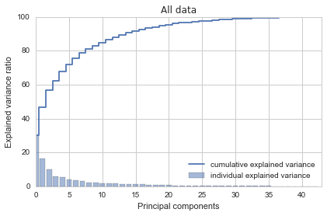
Notes:
It’s a fairly smooth chart; no real elbow.
There’s some possible kink at 4.
8 features 80% of the variance.
15 features gives 90% of the variance.

Slide 18
MODELLING

Slide 19
Train | Test | Not used | Not used | Not used | Not used
Train | Train | Test | Not used | Not used | Not used
Train | Train | Train | Test | Not used | Not used
Train | Train | Train | Train | Test | Not used
Train | Train | Train | Train | Train | Test
Notes:
Cross-validation strategy: want to avoid look-ahead bias; want chronologically contiguous folds.
We also use GridSearchCV to tune hyperparameters of the models

Slide 20
Regression models
Ordinary Least Squares Regression
Ridge Regression
K Nearest Neighbors Regression
Epsilon-Support Vector Regression
Decision Tree Regression
Random Forest Regression
Extra-trees Regression
Bagging Regression (base estimator: Decision Tree Regression)
AdaBoost Regression (base estimator: Decision Tree Regression)
AdaBoost Regression (base estimator: Ordinary Least Squares Regression)

Slide 21
Classification models
Logistic Regression Classification
Gaussian Naïve Bayes Classification
K Nearest Neighbors Classification
C-Support Vector Classification
Decision Tree Classification
Random Forest Classification
Extra-trees Classification
AdaBoost Classification (base estimator: Decision Tree Classification)
Voting Classification

Slide 22
Trade Z | 1 min | 5 min | 10 min | 20 min | 40 min | 80 min
Regression | Decision Tree | Decision Tree | Decision Tree | AdaBoost (Decision Tree) | Random Forest | Random Forest
Up/Down | Random Forest | Random Forest | SVC | SVC | Naïve Bayes | Decision Tree
Categorical | SVC | Decision Tree | SVC | SVC | SVC | Decision Tree
High Categorical | Random Forest | Random Forest | AdaBoost (Decision Tree) | Decision Tree | Random Forest | Random Forest
Default scoring | 1 min | 5 min | 10 min | 20 min | 40 min | 80 min
Regression | Decision Tree | Extra-trees | Random Forest | Ridge | Ridge | Extra-trees
Up/Down | Voting (soft) | Random Forest | Logistic | SVC | SVC | Decision Tree
Categorical | Logistic | Logistic | Logistic | Logistic | Logistic | Voting (hard)
High Categorical | SVC | SVC | SVC | SVC | SVC | SVC
Notes:
We use two types of scoring in the cross validation. The default (e.g., accuracy for classification), and Trade Z = mean(trade pnl) / stdev (trade pnl).
We use GridSearchCV to tuned hyperparameters for the models.
The table shows the best performing model for each horizon, response variable, and scoring method

Slide 23
Trade Z | 1 min | 5 min | 10 min | 20 min | 40 min | 80 min
Regression | 0.163 | 0.040 | 0.101 | 0.037 | 0.071 | 0.121
Up/Down | 0.021 | 0.023 | 0.025 | 0.021 | 0.040 | 0.042
Categorical | 0.029 | 0.027 | 0.034 | 0.033 | 0.039 | 0.075
High Categorical | 0.178 | 0.193 | 0.176 | 0.291 | 0.338 | 0.717
Default scoring | 1 min | 5 min | 10 min | 20 min | 40 min | 80 min
Regression | 9.08x10⁻⁴ | -1.13x10⁻⁴ | -8.16x10⁻⁴ | -2.52x10⁻³ | -4.88x10⁻³ | -5.73x10⁻³
Up/Down | 52.34% | 53.08% | 52.71% | 52.19% | 52.23% | 52.06%
Categorical | 40.60% | 40.30% | 39.87% | 38.85% | 38.56% | 38.97%
High Categorical | 90.84% | 90.96% | 90.73% | 90.97% | 91.04% | 90.94%
Notes:
Here are the cross-validation scores for the different horizons x responses. We show the ‘best’ achieved over all the estimators (the estimator type was shown in the previous slide).

Slide 24
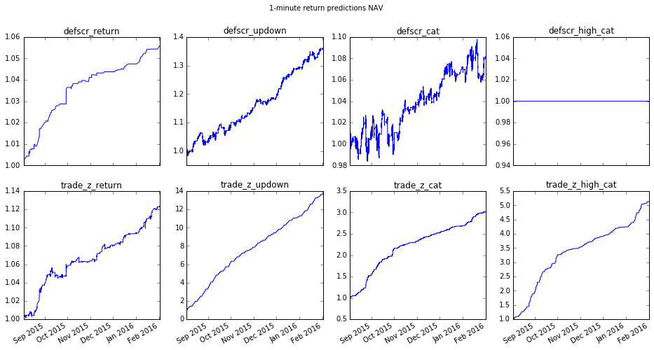
Notes:
Here’s the NAV for the best model for ‘return’, ‘updown’, etc, at 1-min. Blue is the selected model – after tuning hyperparameters we then fit on entire dataset. It’s not bad, but how will it do on data it TRULY hasn’t seen?

Slide 25
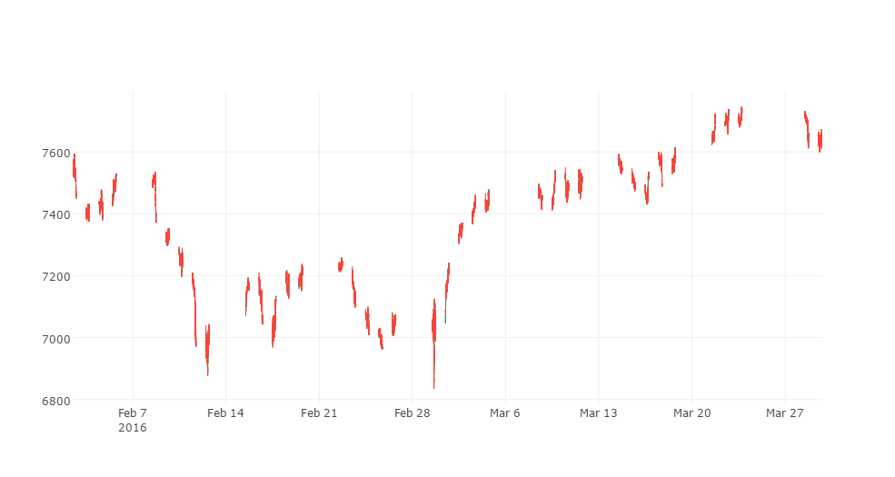
Notes:
We got ahold of some new data – Feb 2 onwards. None of the models have seen this data, let’s see how models perform on this true out of sample.
Note Feb 29 was the India budget release, hence the volatility on that day.

Slide 26
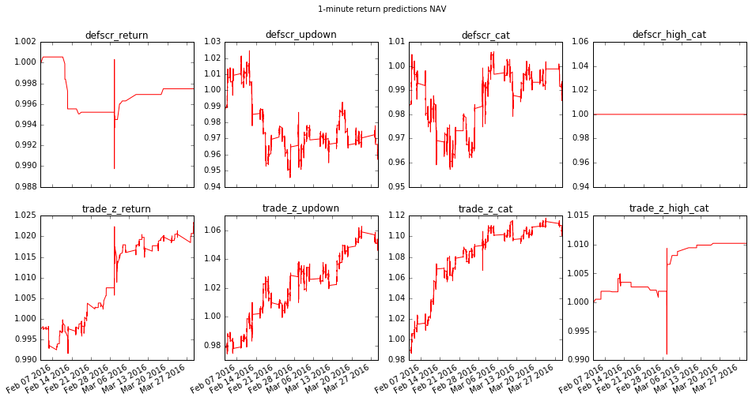
Notes:
Here’s the NAV (start at 1, add the trade returns) for the best model for ‘return’, ‘updown’, etc, at 1-min. Blue is the selected model – after tuning hyperparameters we then fit on entire dataset.
We managed to get some new data for out of sample

Slide 27
buys: 57 | sells: 4 %up: 85.25% mean: 0.000913 std: 0.000978 trade_z: 0.934 | buys: 20387 | sells: 22732 %up: 53.46% mean: 8.37e-06 std: 0.000417 trade_z: 0.0201 raw_accuracy: 53.46% | buys: 12084 | sells: 11670 %up: 52.85% mean: 3.49e-06 std: 0.000503 trade_z: 0.00694 raw_accuracy: 40.99% | buys: 0 | sells: 0 %up: 0.00% mean: nan std: nan trade_z: nan raw_accuracy: 89.67%
buys: 47 | sells: 1042 %up: 60.61% mean: 0.000113 std: 0.000671 trade_z: 0.169 | buys: 21568 | sells: 21551 %up: 100.00% mean: 0.000294 std: 0.000296 trade_z: 0.994 raw_accuracy: 100.00% | buys: 11507 | sells: 12170 %up: 59.89% mean: 8.56e-05 std: 0.000499 trade_z: 0.172 raw_accuracy: 46.25% | buys: 2146 | sells: 2263 %up: 100.00% mean: 0.000939 std: 0.000413 trade_z: 2.27 raw_accuracy: 99.90%
buys: 22 | sells: 1 %up: 39.13% mean: -0.000110 std: 0.00259 trade_z: -0.0423 | buys: 7101 | sells: 6446 %up: 51.69% mean: -2.87e-06 std: 0.000520 trade_z: -0.00552 raw_accuracy: 51.69% | buys: 4490 | sells: 4421 %up: 52.31% mean: -8.39e-07 std: 0.000594 trade_z: -0.00141 raw_accuracy: 39.37% | buys: 0 | sells: 0 %up: 0.00% mean: nan std: nan trade_z: nan raw_accuracy: 89.71%
buys: 30 | sells: 444 %up: 55.91% mean: 4.89e-05 std: 0.00104 trade_z: 0.0469 | buys: 6962 | sells: 6585 %up: 51.69% mean: 3.47e-06 std: 0.000520 trade_z: 0.006678 raw_accuracy: 51.69% | buys: 5076 | sells: 5191 %up: 52.49% mean: 9.89e-06 std: 0.000567 trade_z: 0.0174 raw_accuracy: 38.26% | buys: 26 | sells: 53 %up: 53.16% mean: 0.0001293 std: 0.00201 trade_z: 0.0645 raw_accuracy: 89.67%
Notes:
This is the 1_min_updown trade_z best classifier with 100% in-sample accuracy:
RandomForestClassifier(bootstrap=True, class_weight=None, criterion='gini', max_depth=32, max_features='sqrt', max_leaf_nodes=None, min_samples_leaf=1, min_samples_split=2,
min_weight_fraction_leaf=0.0, n_estimators=100, n_jobs=1, oob_score=False, random_state=None, verbose=0, warm_start=False)
And the 1_min_high_cat trade_z best classifier with 99.90% in-sample accuracy:
RandomForestClassifier(bootstrap=True, class_weight=None, criterion='gini', max_depth=32, max_features='sqrt', max_leaf_nodes=None, min_samples_leaf=1, min_samples_split=2,min_weight_fraction_leaf=0.0, n_estimators=100, n_jobs=1, oob_score=False, random_state=None, verbose=0, warm_start=False)

Slide 28
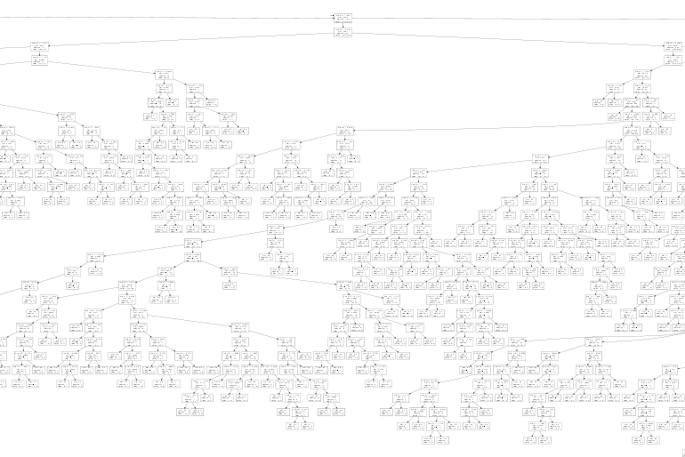
Notes:
Max_Depth 32 is probably overfitting the data – here’s just a small (central) portion of the tree

Slide 29
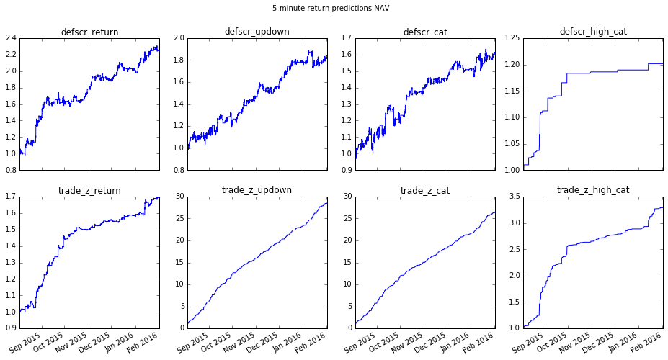
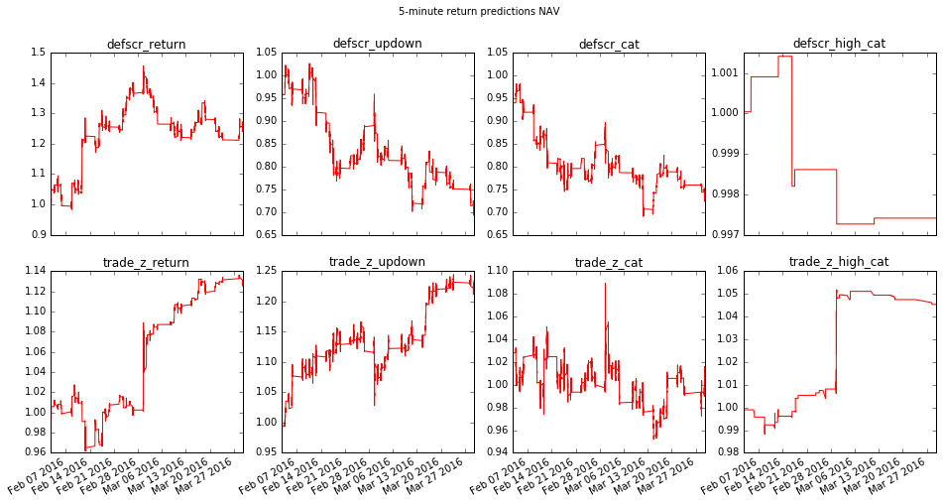
Notes:
Bottom right: [5_min trade_z high cat] one of the better out-of sample.
RandomForestClassifier(bootstrap=True, class_weight=None, criterion='gini', max_depth=16, max_features='sqrt', max_leaf_nodes=None, min_samples_leaf=1, min_samples_split=2, min_weight_fraction_leaf=0.0, n_estimators=10, n_jobs=1, oob_score=False, random_state=None, verbose=0, warm_start=False)
In-sample: buys: 480 | sells: 524 | %up: 99.90% | mean: 0.00228521473718 | std: 0.00112708727209 | trade_z: 2.02754018589 | raw_accuracy: 92.02%
Out-of-sample buys: 53 | sells: 59 | %up: 55.36% | mean: 0.000404677402004 | std: 0.00325466708318 | trade_z: 0.124337571758 | raw_accuracy: 89.47%

Slide 30
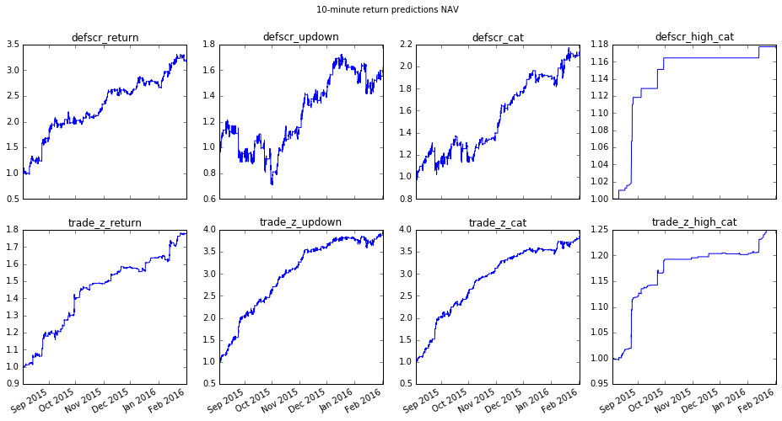
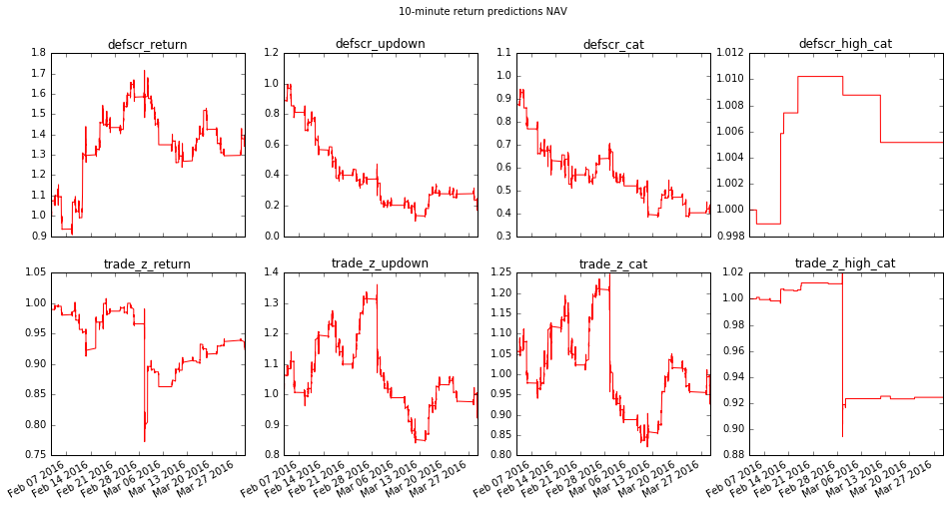
Notes:
Upper right: also positive out of sample performance – but only 10 trades!
10-min defscr high cat
SVC(C=1, cache_size=1024, class_weight=None, coef0=0.0, decision_function_shape=None, degree=3, gamma='auto', kernel='rbf', max_iter=-1, probability=False, random_state=None, shrinking=True, tol=0.001, verbose=False)
in-sample buys: 20 | sells: 34 | %up: 98.15% | mean: 0.00328566870036 | std: 0.0013585175972 | trade_z: 2.41856911322 | raw_accuracy: 89.82%
out-of-sample buys: 0 | sells: 10 | %up: 50.00% | mean: 0.000516589979197 | std: 0.00200929410934 | trade_z: 0.25710023077 | raw_accuracy: 89.72%

Slide 31
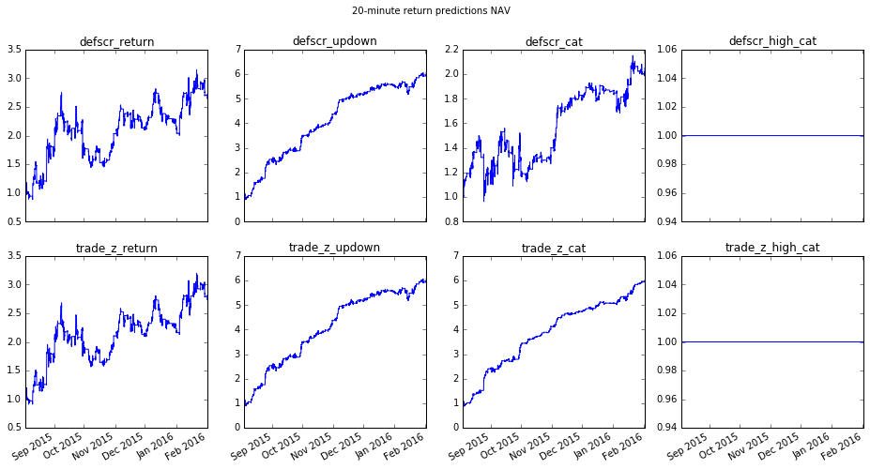
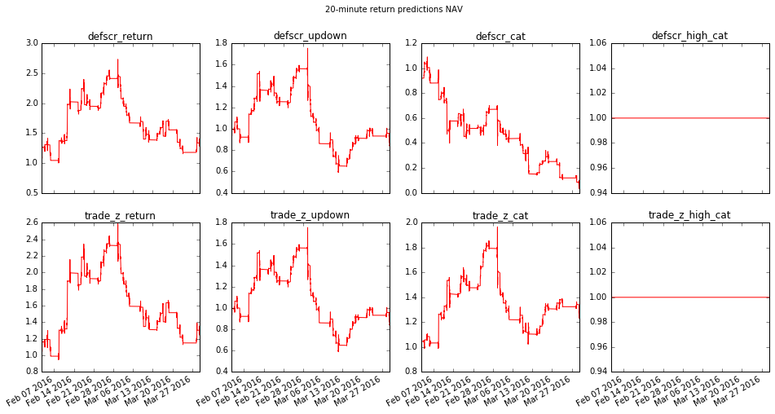

Slide 32
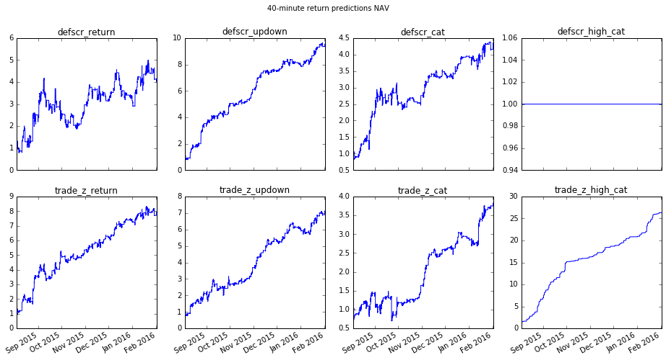
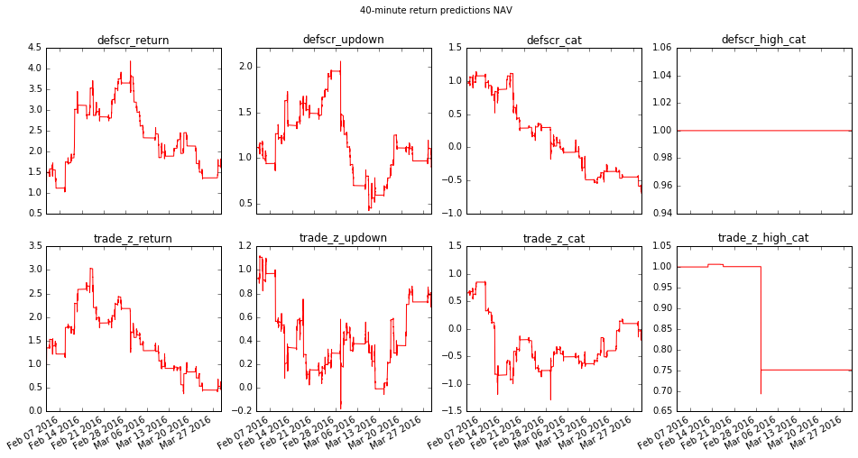

Slide 33
